Slide 1
An Introduction to Spatial Regression
Slides based to a large extent on the GeoDa Workbook by Luc Anselin
https://geodacenter.github.io/documentation.html

Slide 2

Recall from Last Time:
Spatial Autocorrelation is…
Similar to correlation, but…
  Instead of examining the association between two variables, we look at the relationship of values within a single variable at nearby locations
There is said to be (positive) spatial autocorrelation in a variable if observations that are closer to each other in space have related values (i.e., recall Tobler’s Law)
There is said to be negative spatial autocorrelation in a variable if observations that are closer to each other have markedly different values (e.g., repulsion)
  Happens fairly rarely. We’ll focus on positive SA
- SA

Slide 3
Why Spatial Autocorrelation Matters
Spatial autocorrelation gives us interesting information about a spatial process
  E.g., house prices in nearby areas are similar
Additionally, a vital assumption of most statistical analyses (e.g., OLS regression) is that observations are independent of each other
  When spatial autocorrelation is present, values of a variable in nearby areas are related to each other and are NOT independent
In ordinary least squares regression (OLS), for example, the beta coefficients might be incorrectly estimated and the error term – which is supposed to be random noise – may have meaningful information in it

Slide 4
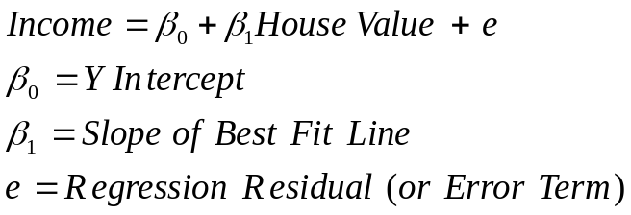
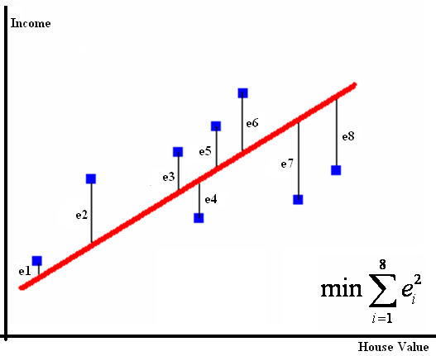
Review: Assume you want to find the best-fit line for the following 8 points
Here, e1 represents the vertical distance between point 1 and the best-fit line, e2 represents the vertical distance between point 2 and the best-fit line, and so on.
At point 8, residual e8 is the difference between the actual value of income (blue square) and the value of income predicted by the line (star). Here the residual is going to be negative and we end up with an overprediction.
At point 6, the residual e6 will be positive, and we will end up with an underprediction.
If we have systematic over- or under- prediction for certain areas, then we have a problem with our model, as residuals aren’t supposed to have any non-random patterns in them
Stars: predicted values
Squares: actual values

Slide 5
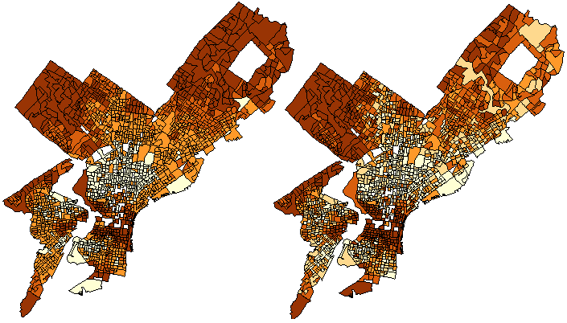
Example
Examine the relationship between median house value (dependent variable) and % of individuals who have at least a bachelors degree (independent variable)
Data at Philadelphia block group level (1720 block groups after data cleaning)
Median House Value % with Bachelors
…Darker colors represent higher values…
DV IV

Slide 6
OLS Regression Results
-----------------------------------------------------------------------
Variable Coefficient Std.Error t-Statistic Probability
-----------------------------------------------------------------------
CONSTANT (β0) 28104.98 1388.192 20.24574 0.0000000
PCTBACHMOR (β1) 2374.347 57.93272 40.98455 0.0000000
-----------------------------------------------------------------------
Education is significantly associated with median house value (p=0.00000<0.05)
A one unit (i.e., percentage point) increase in the percentage of individuals with at least a bachelors degree corresponds to a $2,374.35 increase in median house value
Recall that β0 (represented by “CONSTANT” in the output) is just the median house value in a tract where % of individuals with at least a bachelor’s degree=0.
  Think y-intercept b in the y=mx+b equation
What about the residuals?

Slide 7
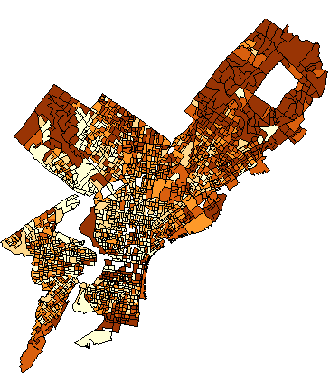
Let’s Examine Regression Residuals for Spatial Autocorrelation
But… are there spatial dependencies in in the residuals?
That is, do you see any patterns?
  Underprediction?
  Overprediction?
How can we test for for spatial autocorelation?
Dark areas: high residuals -> systematic underprediction in NE and NW Philly (black circles)
Light areas: low residuals -> systematic overprediction in North Philly (blue circle)

Slide 8
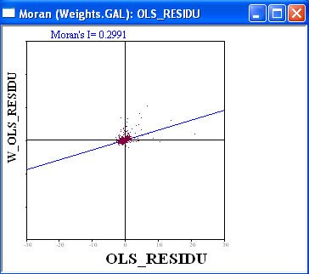
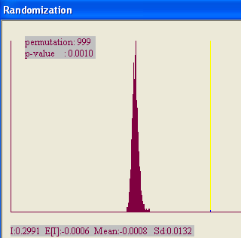
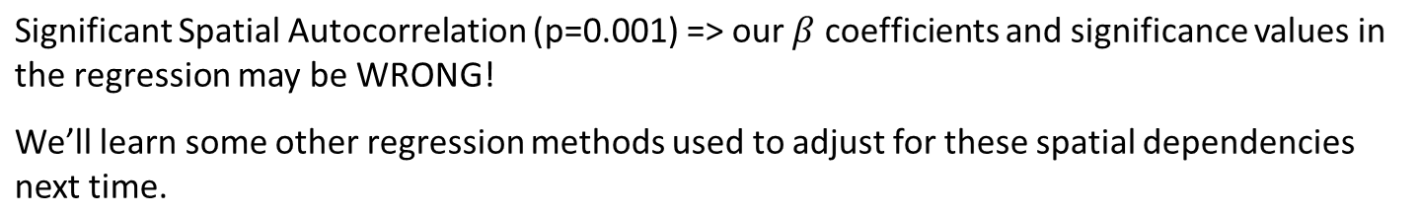
Testing for SA in Residuals
Queen Weight Matrix Used

Slide 9
Lagged Variables (Temporal Case)
Assume you’re looking at predictors of GDP in different countries in the year 2008.
  Let’s denote it as GDPtime (where time=2008)
One predictor of 2008 GDP may be 2007 GDP
  Let’s denote it as GDPtime-1 (where time-1= 2008-1=2007)
  The value of GDP in the previous period (i.e., at time t-1) is called the first lag of GDP.
    By that logic, the value of GDP 2 time periods (years) ago is called the second lag, and the value of GDP k time periods (years) ago is called its k^{th} lag.

Slide 10
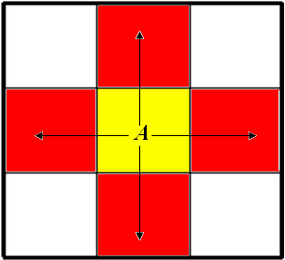
Lagged Variables (Spatial Case)
A spatial lag of a variable is the value of that variable at its neighboring spatial unit(s)
  Neighbors are as defined in the weight matrix (e.g., rook, queen, nearest neighbor, etc)
  E.g., the spatial lag of house price at tract A is the value of house price in tract A’s neighbor (if there is more than one neighbor, it’s the average house price in tract A’s neighbors)
Assume we’re using a rook weight matrix as shown. The rook neighbors of A will be B, C, D and E. So the spatial lag of house price for tract A will be the average of house price in tracts B, C and D, E
Which raster operation is this similar to?
B
C D
E

Slide 11
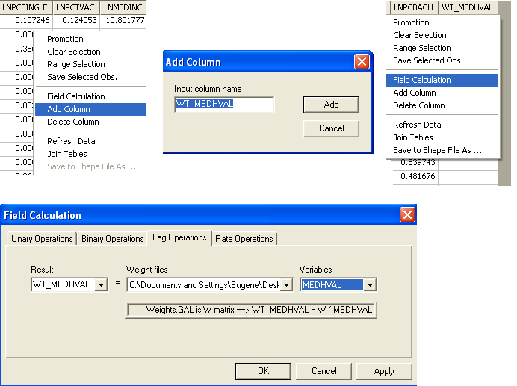
In GeoDa…

Slide 12
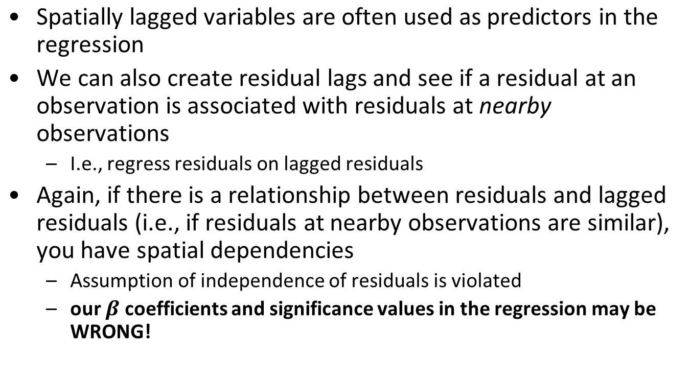
Residual by Lagged Residual Plot
(or Residual by Nearest Neighbors Residual Plot)

Slide 13
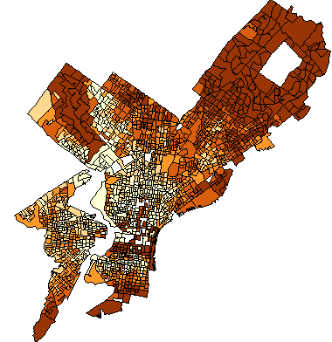
Residuals Lagged Residuals
DO THESE MAPS LOOK SIMILAR?

Slide 14
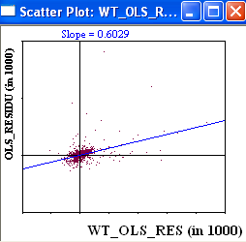
Regress Residuals on Lagged Residuals
-----------------------------------------------------------------------
Variable Coefficient Std.Error t-Statistic Probability
-----------------------------------------------------------------------
CONSTANT -752.5008 932.5533 -0.8069253 0.4198292
LAGGED_RES 0.6029393 0.03101541 19.43999 0.0000000
-----------------------------------------------------------------------
Neighboring residuals are statistically significantly associated with each other
Look at the β coefficient of the lagged residual term: As the lagged residual changes by 1 unit, residual changes by 0.602 units*
* In spatial error regression, we will be doing something similar, but there, the coefficient of the lagged residuals will be called λ and constrained between -1 and 1.

Slide 15
Does High Spatial Autocorrelation in the Dependent Variable Imply High Spatial Autocorrelation in the Regression Residuals?

Slide 16
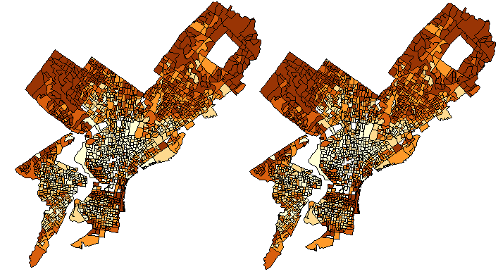
Not Necessarily!
Example: Regress Median income of females on median income of males
Dep. Var. = INCOME (Females) Predictor=INCOME (Males)
-- Both variables are strongly autocorrelated (Moran’s I > 0.5, p=0.001)
-- The correlation between the two variables seems very high – i.e., males have high income in areas where females have high income, and males have low income in areas where females have low income!

Slide 17
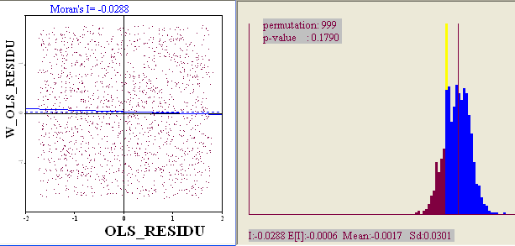
Regression Results
Dependent Variable : MEDINC_F
-----------------------------------------------------------------
Variable Coefficient Std.Error t-Statistic Probability
-----------------------------------------------------------------
CONSTANT 26.99119 30.35717 0.8891207 0.3740771
MEDINC_M 0.9985092 0.0008545074 1168.52 0.0000000
-----------------------------------------------------------------
NO SPATIAL AUTOCORRELATION IN THE RESIDUALS!!!

Slide 18
To Summarize…
The dependent variable is strongly autocorrelated, but error term is NOT -> Spatial autocorrelation does NOT lead to problems in this situation (regression coefficients and significance levels are valid)
If both the dependent variable y and independent variable x have essentially identical spatial “patterns”, and the spatial dependencies in y have been accounted for by the spatial dependencies in x, that can potentially lead to spatially independent residuals
  This is a relatively rare occurrence when there is only one predictor
  Even if the dependent and independent variables are strongly correlated, the residuals may still exhibit spatial autocorrelation
Often, adding extra predictors in the regression will take care of spatial autocorrelation in the residuals
  Spatial patterns in the predictors will account for the spatial pattern in the dependent variable
General rule: if you’re dealing with regression analysis in a spatial context, ALWAYS check regression residuals for spatial autocorrelation!
  If spatial autocorrelation is present, you need to adjust for it!!!

Slide 19
Models That Account for Spatial Autocorrelation in the Data
Spatial Error
Spatial Lag
Geographically Weighted Regression
And a number of others beyond the scope of this course
  Conditional Autoregressive Model
  Spatial Filtering by Eigenvectors

Slide 20
Sample Problem
Examine the relationship between median house value (dependent variable) and % of individuals who have at least a bachelors degree (independent variable)
Data at Philadelphia block group level (1720 block groups after data cleaning)
Median House Value % with Bachelors
…Darker colors represent higher values…
DV IV

Slide 21
OLS Regression Results
-----------------------------------------------------------------------
Variable Coefficient Std.Error t-Statistic Probability
-----------------------------------------------------------------------
CONSTANT (β0) 28104.98 1388.192 20.24574 0.0000000
PCTBACHMOR (β1) 2374.347 57.93272 40.98455 0.0000000
-----------------------------------------------------------------------
Education is significantly associated with median house value (p=0.00000<0.05)
A one percentage point increase in the percentage of individuals with at least a bachelors degree corresponds to a $2,374.35 increase in median house value
Recall that β0 (represented by “CONSTANT” in the output) is just the median house value in a tract where % of individuals with at least a bachelor’s degree=0.
  Think y-intercept b in the y=mx+b equation
Also recall that the error term, ε, is supposed to be indistinguishable from random noise.
  That is, the error term shouldn’t be associated with any variables, or with location -> there shouldn’t be overprediction or underprediction based on location

Slide 22
Heteroscedasticity
Recall that regression residuals should not have any pattern to them – spatial or otherwise. They should be random noise.
However, the variance in the residuals may change with values of another variable. That is, we have heteroscedasticity
  Hetero: different
  Scedasticity: dispersion
The opposite of heteroscedasticity is homoscedasticity, which is one of regression assumptions which we haven’t covered before!
  i.e., residuals have constant variance!

Slide 23
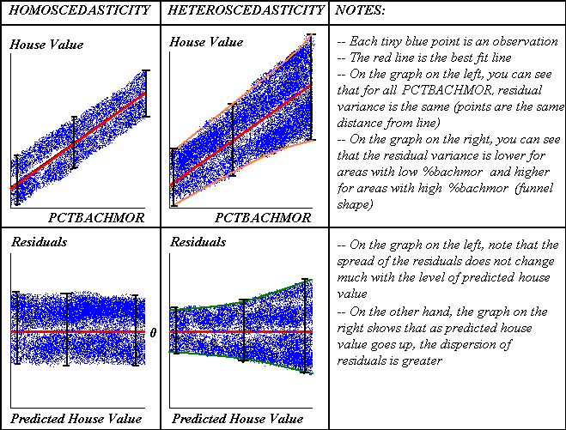
Residual by Predicted Plot Y-X Scatter Plot

Slide 24
Testing for Heteroscedasticity in GeoDa
First of all, we can save OLS residuals and predicted values and do a residual-by-predicted scatter plot as on the previous page.
  If dispersion of residuals varies by level of predicted variable, we have heteroscedasticity
Secondly, GeoDa has three different diagnostics for heteroscedasticity:
  The Breusch-Pagan Test (T.S. Breusch & A.R. Pagan; Simple test for heteroscedasticity and random coefficient variation. Econometrica 47 (1979), pp. 1287–1294)
  The Koenker-Bassett Test (For more info: R. Koenker & G. Bassett; Robust Tests for Heteroscedasticity Based on Regression Quantiles, Econometrica 50 (1982), pp. 43-61)
  The White Test (H. White; A Heteroskedasticity-Consistent Covariance Matrix Estimator and a Direct Test for Heteroskedasticity, Econometrica 48 (1980), pp. 817–838)
The null hypothesis here is that of homoscedasticity (i.e., NO heteroscedasticity). If the p-value is less than 0.05, then we can reject the null hypothesis for the alternate hypothesis of heteroscedasticity.
OUR EXAMPLE…
DIAGNOSTICS FOR HETEROSKEDASTICITY
RANDOM COEFFICIENTS
TEST DF VALUE PROB
Breusch-Pagan test 1 5484.085 0.0000000
Koenker-Bassett test 1 251.6122 0.0000000
SPECIFICATION ROBUST TEST
TEST DF VALUE PROB
White 2 330.711 0.0000000
All 3 tests indicate that there is heteroscedasticity -> PROBLEM!

Slide 25
Normality of the Residuals (Errors)
Errors should be random noise (i.e., contain no systematic meaningful information).
They should also be normally distributed
The Jarque-Bera test in GeoDa examines the Null Hypothesis that the residuals are from a normal distribution.
  For more information, see: http://en.wikipedia.org/wiki/Jarque%E2%80%93Bera_test
  If p<0.05, reject the Null Hypothesis of normality for the alternative hypothesis of non-normality!
    Non-normality: problematic!
OUR EXAMPLE…
TEST ON NORMALITY OF ERRORS
TEST DF VALUE PROB
Jarque-Bera 2 130989.9 0.0000000
We have non-normality of errors -> PROBLEM!

Slide 26
What To Do If There Are Still Problems?
Problems:
  Heteroskedasticity
  Multicollinearity (multicollinearity condition # >30)
  Non-normality
  Spatial autocorrelation
Solutions:
  Transform variables to make them more normal
  Take out/add predictors
  Try spatial regression models with different weight matrices

Slide 27
Summary
Spatial autocorrelation (SA)
Problems spatial autocorrelation may cause in OLS regression analysis
  When SA is present, we may see some meaningful patterns in the residuals (i.e., consistent over or under predictions in nearby areas)
Alternative regression models needed to account for spatial dependencies

Slide 28
Spatial Regression Models
We’ll cover two spatial regression models, available in GeoDa:
  Spatial Lag
  Spatial Error
In addition to the independent variables entered into the OLS model, the spatial regression models include terms, known as rho (ρ) in the spatial lag model and lambda (λ) in the spatial error model, which account for spatial autocorrelation.
  NOTE: In some literature, the parameter names are reversed (rho (ρ) in the spatial error model and lambda (λ) in the spatial lag model).
  If spatial autocorrelation is present and is ignored in the model, the significance of the β coefficients may be overestimated
Notes:
*Tony Smith, Bulkpack, p. 68.

Slide 29
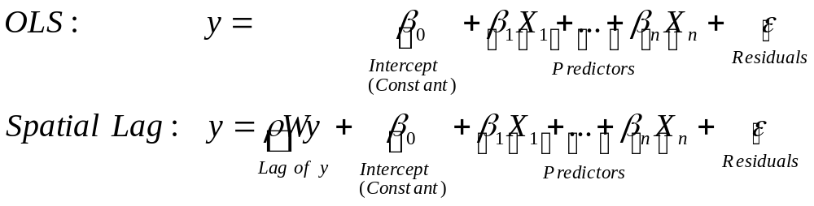
Spatial Lag Model
Assumes that the value of the dependent variable at one location is associated with the values of that variable in nearby locations
  ‘Nearby’ is as defined by the weights matrix W (rook, queen, within a certain distance of one another)
In other words, the model includes the spatial lag of the dependent variable as a predictor
Here, ρ (rho) is the coefficient of the y-lag variable Wy, similar to how β1 is the coefficient of the variable X1
Note: here, ρ is constrained between -1 and 1

Slide 30
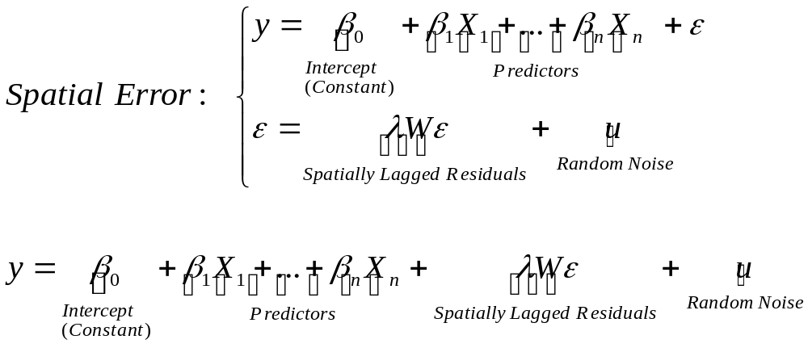
Spatial Error Model
Assumes that the residual at one location is associated with residuals at nearby locations
  ‘Nearby’ is as defined by the weights matrix W (rook, queen, within a certain distance of one another)
Practically, we have a two-step (stage) regression:
  First, we run our OLS regression, where we regress Y on the predictors
  Secondly, we regress residuals on the nearest neighbor residuals, thereby filtering the spatial information out of the OLS residuals and decomposing the residuals (ε) into two parts: one with a spatial pattern (λWε) and one which is simply random noise (u).
    The part with a spatial pattern can be thought of as some variable with a spatial component missing from the (first) regression
    Note: λ is constrained between -1 and 1
Notes:
Think of this model as one that is missing a spatial predictor variable and therefore the residuals are autocorrelated.

Slide 31
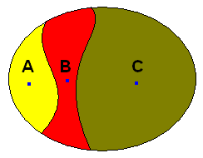
Weight Matrices & Spatial Regression
GeoDa manual states that you should only be using symmetric weight matrices for spatial regression analysis
  That is, if A is a neighbor of B, B is a neighbor of A
  Symmetric matrices include:
    Rook
    Queen
    Centroids within a distance of each other
  Is k-nearest neighbors a symmetric weight matrix?
    If the tract closest to tract A is tract B, is it necessarily the case that the tract closest to tract B is tract A?
      Recall that here, “closeness” is measured by distance between the centroids of tracts A and B
…The nearest neighbor of C is B, but the nearest neighbor of B is A…
Recall that there’s no problem using the k-nearest neighbors weight matrix for checking spatial autocorrelation (e.g., Moran’s I) – it’s problematic only for spatial regression!

Slide 32
Some Things to Note…
Good to try spatial regression with different weights (excluding, of course, the asymmetric k-nearest neighbors matrix)
GeoDa has difficulty running spatial regression when you have more than 50,000-100,000 observations
  Reason: in order to estimate the regression, you need to perform a mathematical manipulation known as matrix inversion, which is very difficult and time consuming to do when you have a large matrix
The interpretation of the beta coefficients in the Spatial Error Model is the same as in OLS. However, the interpretation of the beta coefficients in the Spatial Lag Model is fairly complicated and beyond the scope of this course. For those interested, it is described in detail in a separate file on Canvas called ‘Lecture 12 - Tony Smith - Interpretation of Beta Coefficients in Spatial Regression.pdf’.

Slide 33
Goals & Assumptions of Spatial Lag/Spatial Error Regression
Goal: to take into consideration the fact there may be spatial dependencies in the residuals/the data
Spatial Lag & Spatial Error methods might result in residuals which are:
  No longer spatially autocorrelated
  Less heteroscedastic
Keep in mind that we still assume that each of the predictors is linearly related with the DV, that the residuals are normal, and that there should not be multicollinearity.

Slide 34
Which Spatial Model to Pick?
Step 1: Run OLS regression and examine residuals for spatial autocorrelation (Moran’s I). If there is no significant spatial autocorrelation in the residuals, stop. If there is significant spatial autocorrelation in residuals, go on to step 2.
Step 2: Run the spatial lag and spatial error models and examine residuals in each model for spatial autocorrelation. Pick model which accounts for spatial autocorrelation (it’s possible that both or neither of the lag and error models account for it).

Slide 35
A Different Approach
After running the OLS regression, look at the LM (Lagrange Multiplier) Diagnostics in the regression output (below)
  The method of Lagrange multipliers provides a strategy for finding the maximum/minimum of a function subject to constraints (http://en.wikipedia.org/wiki/Lagrange_multipliers#Interpretation_of_the_Lagrange_multipliers). This is a very mathematically sophisticated method.
  Here, it tells you whether you should run a spatial lag or spatial error model:
    First, look at the Lagrange Multiplier (lag) and the Lagrange Multiplier (error). If neither is significant (p>0.05 for both), then STOP. OLS is good enough!
    If Lagrange Multiplier (lag) is significant and Lagrange Multiplier (error) is not, then run the spatial lag model
    If Lagrange Multiplier (error) is significant and Lagrange Multiplier (lag) is not, then run the spatial error model
    If both are significant (as here), look at Robust LM (lag) and Robust LM (error). Choose the one that is more significant (i.e., has a LOWER p-value or HIGHER test statistic value) and run that model.
      Here, both Robust LM (lag) and Robust LM (error) are highly significant, and the p-values are the same (0.000000). However, the value of the Robust LM (lag) test statistic is higher than the value for the Robust LM (error) test statistic (173.156>102.500)
      So here, we would run the spatial lag model because 173.156>102.500
TEST MI/DF VALUE PROB
Moran's I (error) 0.444305 N/A N/A
Lagrange Multiplier (lag) 1 1059.3134682 0.0000000
Robust LM (lag) 1 173.1556549 0.0000000
Lagrange Multiplier (error) 1 988.6579812 0.0000000
Robust LM (error) 1 102.5001679 0.0000000

Slide 36
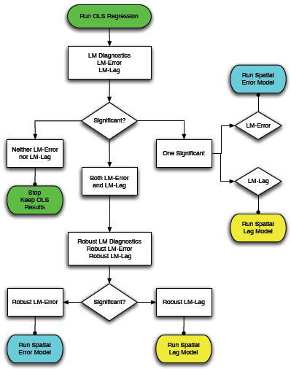
Decisions, Decisions: Which Model to Choose?
-- OLS
-- Spatial Lag
-- Spatial Error
N.B.: If both Robust LM-Error and Robust LM-Lag are significant, then choose the one that is more significant (i.e., has a lower p-value or higher test statistic)
Source: https://geodacenter.github.io/documentation.html

Slide 37
Running the Spatial Lag/Error Model in GeoDa
Construct a spatial weights matrix (e.g., Queen).
On the main menu, click Regression
Select your dependent and independent variables, as with OLS.
Select the weights matrix and indicate whether you want to run a Spatial Lag (or Spatial Error) model.
Check ‘White Test’ to include the results of the test in the output
Click Run.
Once the model finishes running, go back to dialog box and click Save to Table, select ‘Residual’, and click OK.
  This adds a column with spatial lag (or spatial error) residuals to your attribute table.

Slide 38
Comparing Spatial Lag Results and OLS Results
Note the coefficient of the spatial autoregressive parameter ρ, denoted as W_’Name_of_Dependent_Variable’ in the regression output: is it significant?
  Recall that this is the spatial lag of the dependent variable entered as a predictor of the dependent variable. That is, it’s the value of the dependent variable in nearby areas
  Assume our dependent variable is MEDHVAL. If W_MEDHVAL (i.e., lag of MEDHVAL) is significant (p<0.05), then median house value in an area is associated with median house value in surrounding areas!
Note the difference in the Beta coefficients of the CONSTANT and PCTBACHMOR terms in the two regressions.
OUR EXAMPLE…
OLS Results
-----------------------------------------------------------------------
Variable Coefficient Std.Error t-Statistic Probability
-----------------------------------------------------------------------
CONSTANT (β0) 28104.98 1388.192 20.24574 0.0000000
PCTBACHMOR (β1) 2374.347 57.93272 40.98455 0.0000000
-----------------------------------------------------------------------
Spatial Lag Results
----------------------------------------------------------------------
Variable Coefficient Std.Error z-value Probability
----------------------------------------------------------------------
W_MEDHVAL 0.5483688 0.04143633 13.23401 0.0000000
CONSTANT 10849.34 5235.001046 2.072 0.0383000
PCTBACHMOR 1153.834 500.0204463 2.306 0.0211000
----------------------------------------------------------------------

Slide 39
Spatial Lag Regression Diagnostics
R² no longer has the same interpretation as in OLS – it’s a pseudo R².
  Best not to touch it
Breusch-Pagan test for heteroscedasticity
  If p<0.05, we still have heteroscedasticity, which is a problem!
OUR EXAMPLE…
REGRESSION DIAGNOSTICS
DIAGNOSTICS FOR HETEROSKEDASTICITY
RANDOM COEFFICIENTS
TEST DF VALUE PROB
Breusch-Pagan test 1 2073.38 0.0000000
We still have significant heteroscedasticity -> Problem!
Notes:
The models are fitted with maximum likelihood, so R squared is not a very suitable measure, although you can find various ways of computing them (See
https://stats.oarc.ucla.edu/other/mult-pkg/faq/general/faq-what-are-pseudo-r-squareds for some examples of the way pseudo R-squared is calculated for different models). On the other hand, you can get the AIC and log-likelihood for OLS and some other models, and they provide a way of comparing models.

Slide 40
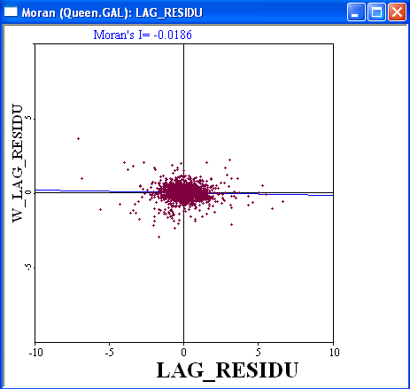
Spatial Lag Regression Diagnostics (Cont’d)
As with OLS, we can examine spatial lag regression residuals for spatial autocorrelation using Moran’s I.
  Here it’s -0.018, i.e., very small.

Slide 41
Tools for Model Comparison
When you run several models, how do you compare them? A number of measures that can be used for model comparability:
  Akaike Information Criterion (AIC)
  Schwartz Criterion (SC)
    AIC and SC are measures of the goodness of fit of an estimated statistical model. They are relative measures of the information that is lost when a given model is used to describe reality and can be said to describe the tradeoff between precision and complexity of the model.
    In GeoDa, the lower the AIC and SC, the better the fit
  NOTE: AIC is not interesting in and of itself – you need at least two models for which you can compare the AIC values. (Same with SC).
OUR EXAMPLE…
OLS:
Akaike info criterion : 37284.5
Schwarz criterion : 37295.4
Spatial Lag
Akaike info criterion : 36885.9
Schwarz criterion : 36902.2
We see that the AIC and SC are smaller for the Spatial Lag model, indicating that the Spatial Lag model is a better fit than OLS.
Sources:
(1) http://en.wikipedia.org/wiki/Maximum_likelihood (2) http://en.wikipedia.org/wiki/Akaike_information_criterion
(3) https://geodacenter.github.io/documentation.html

Slide 42
Tools for Model Comparison
Log Likelihood
  Associated with the maximum likelihood method of fitting a statistical model to the data and estimating model parameters
    Maximum likelihood picks the values of the model parameters that make the data "more likely" than any other values of the parameters would make them.
  The higher the log likelihood, the better the model fit
    I.e., you want the less negative log likelihood
  Should be used for comparing nested models only
    OLS is a special case of spatial lag and spatial error models
      Drop spatial term and the spatial regression models reduce to OLS: nesting
    Spatial lag and spatial error are not a special case of each other – we cannot use the log likelihood ratio to compare them
OUR EXAMPLE…
OLS Log likelihood: -18640.2 (from OLS output)
Spatial Lag Log likelihood: -18439.9 (from Spatial Lag output)
We see that the Spatial Lag Log Likelihood is higher, indicating that it’s a better model than OLS
Notes:
Linear Regression: Maximum likelihood estimation and OLS estimation yield the same values of the betas. Not always the case.

Slide 43
Tools for Model Comparison (Cont’d)
Likelihood ratio test: compares the OLS model with the spatial model (again, only used for nested models)
  Null Hypothesis: Spatial lag (error) model is not a better specification than the OLS model
  If p<0.05, we reject the null hypothesis, and state that the spatial lag (error) model is doing a better job than the OLS model
OUR EXAMPLE…
DIAGNOSTICS FOR SPATIAL DEPENDENCE
SPATIAL LAG DEPENDENCE FOR WEIGHT MATRIX : Queen.GAL
TEST DF VALUE PROB
Likelihood Ratio Test 1 400.6066 0.0000000
We see that the spatial lag model is a better specification than OLS
See: http://en.wikipedia.org/wiki/Likelihood-ratio_test

Slide 44
Spatial Error Regression Diagnostics
The coefficient of the spatial parameter λ, denoted as Lambda in the regression output: is it significant?
  Recall that this is the spatial lag of the OLS regression residuals entered in the regression.
  Note the values of the CONSTANT and PCTBACHMOR terms and their corresponding significance levels in the two regressions!
OLS Results
-----------------------------------------------------------------------
Variable Coefficient Std.Error t-Statistic Probability
-----------------------------------------------------------------------
CONSTANT (β0) 28104.98 1388.192 20.24574 0.0000000
PCTBACHMOR (β1) 2374.347 57.93272 40.98455 0.0000000
-----------------------------------------------------------------------
Spatial Error
-----------------------------------------------------------------------
Variable Coefficient Std.Error z-value Probability
-----------------------------------------------------------------------
CONSTANT 41664.78 2134.04522 19.52385 0.0000000
PCTBACHMOR 1424.857 940.7511 1.51460 0.1301000
LAMBDA 0.6003913 0.027406 21.907294 0.0000000
-----------------------------------------------------------------------

Slide 45
Spatial Error Regression Diagnostics
Everything else is the same as with SPATIAL LAG:
  Regression Diagnostics
    R-squared no longer has the same interpretation as in OLS
    Breusch-Pagan test for heteroscedasticity
    We can examine spatial error regression residuals for spatial autocorrelation using Moran’s I
  Tools for Model comparison
    Use AIC and SC to compare OLS and Spatial Error models
    Use Log Likelihood and the Likelihood Ratio Test to compare Spatial Error model with OLS
      Recall that these are tests for nested models, and that OLS is a special case of the Spatial Error model (where the coefficient of the weighted residuals term is zero)

Slide 46
Spatial Lag vs. Spatial Error
Use Lagrange Multipliers/Robust Lagrange Multipliers
You may use the AIC and SC to compare these models
You may also look at the spatial autocorrelation in the model residuals to see which one does a better job of accounting for it
Do not use the log likelihood, the likelihood ratio tests, or R-squared to compare these models.

Slide 47
Implementation of Spatial Lag and Spatial Error Models
The GeoDa Workbook, available at https://geodacenter.github.io/documentation.html, may be of help
The R Markdown, available on Canvas, will guide you through the implementation of the models in R

